Slide 1
Cville Tool Library final presentation
Exactly what we’d hoped for, and more!

Slide 2
Way back in July 2021:
Our application stated that we would “take the Cville Tool Library from its initial organizing to a pilot launch in 2022. Specifically we wanted to:
Secure organizational and fiscal sponsorship–Done (Virginia Organizing)
Develop fundraising plan and start fundraising–Ongoing
Secure location for pilot launch–Done (1740 Broadway Street, no cost lease)
Design and prepare for pilot launch activities–Wrapping up
The more than expected has to do with the team we’ve built to do this, and the amazing amount of work that’s been done. For instance:

Slide 3
Our communications team developed a logo
and built a fantastic website that has membership information, tool inventory information and ways to get involved. It links directly to MyTurn, a lending platform we decided to invest in.
www.cvilletoollibrary.com.

Slide 4
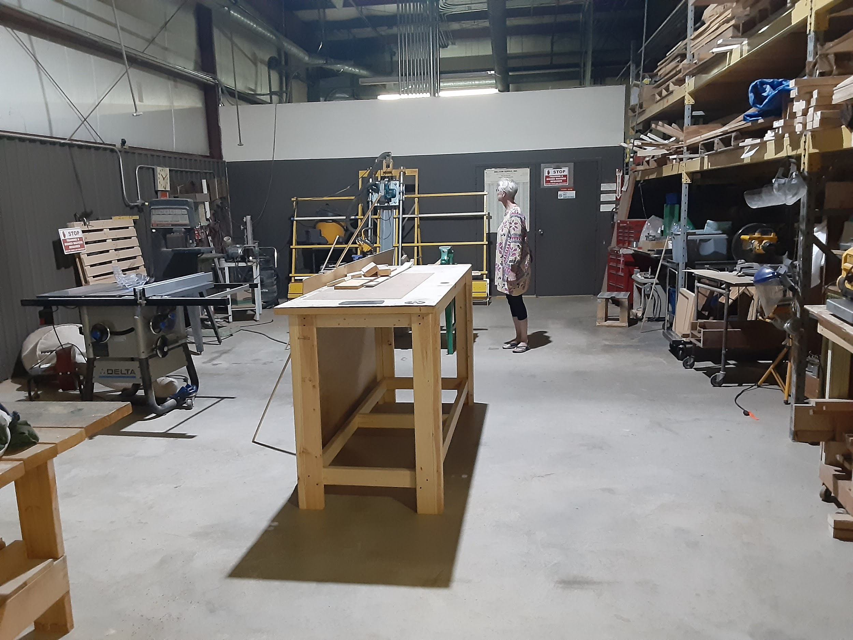
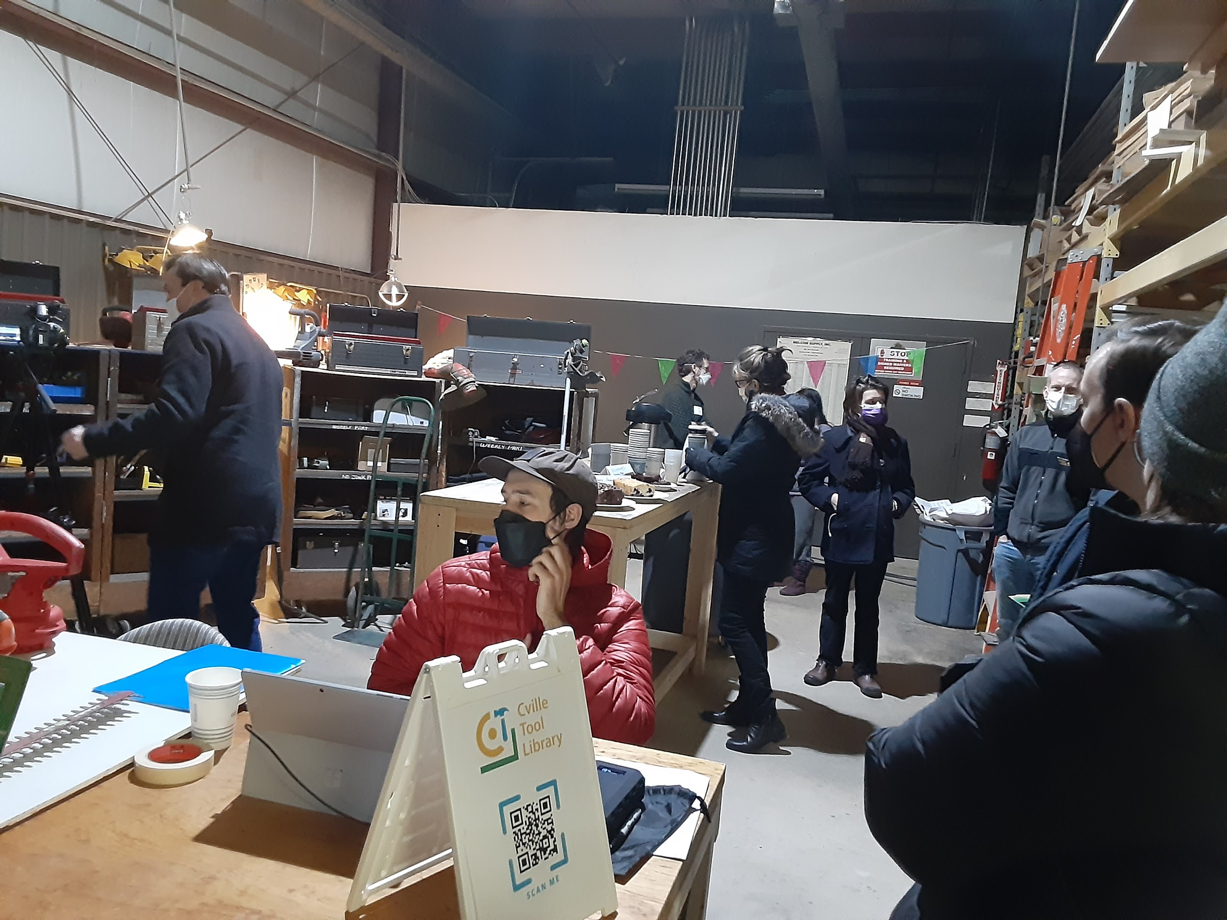
We’ve all worked together and have accomplished more than any of us imagined.

Slide 5
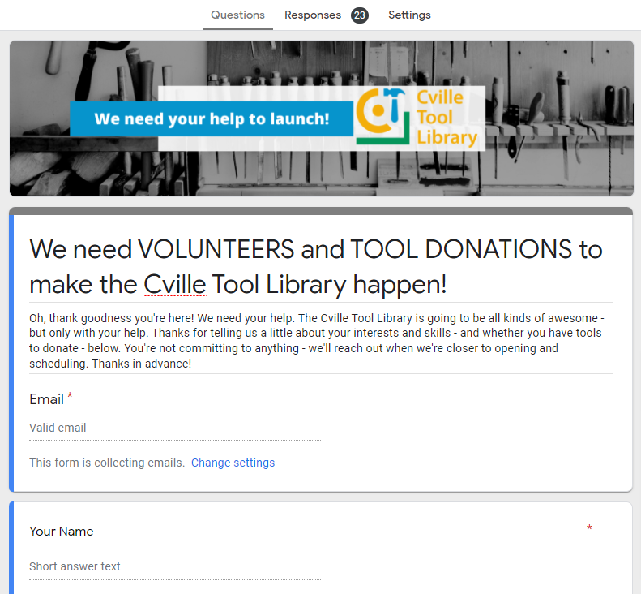
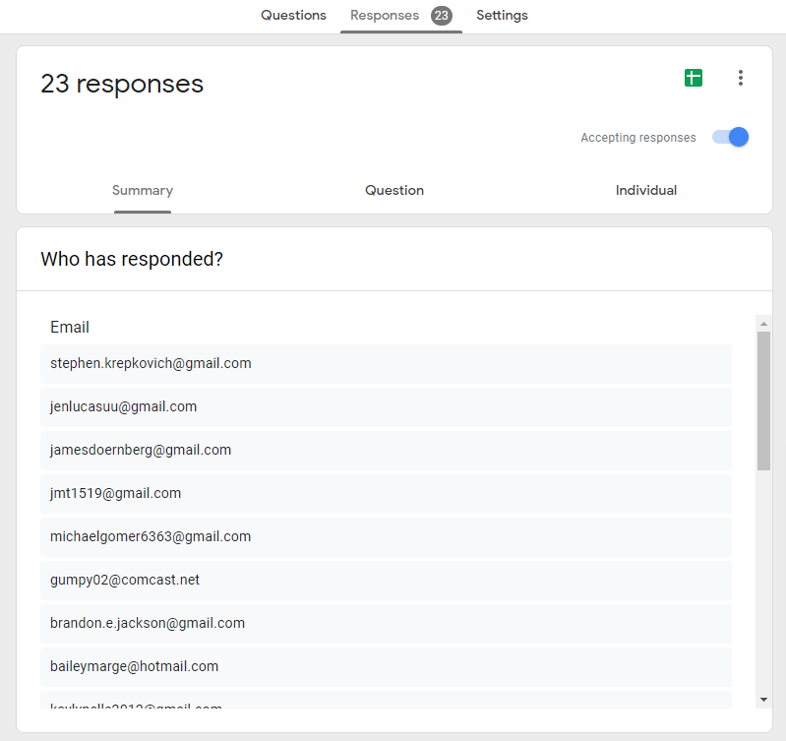
We have over 30 volunteers signed up, and lots of tools donated.

Slide 6
Our launch is scheduled for March 19th.
We’ve scheduled two types of volunteer training–tool maintenance, and front-desk/librarian. We have weekly work days at the library space, and collect donated tools on an ongoing basis. We’ve set a starting schedule–Thursday evenings from 4-7, and Saturdays from 9 to noon. We are finalizing an online safety training and basic MyTurn training for all volunteers and members. We’ve got a regularly scheduled advisory group meeting. So far 50 people have signed up as members, and we have almost 350 tools inventoried and in MyTurn.
And, I think we’ve all been enjoying the process. Come visit us! 1740 Broadway Street.

Slide 7
