Slide 2
Empowering
Community Archives

Slide 4
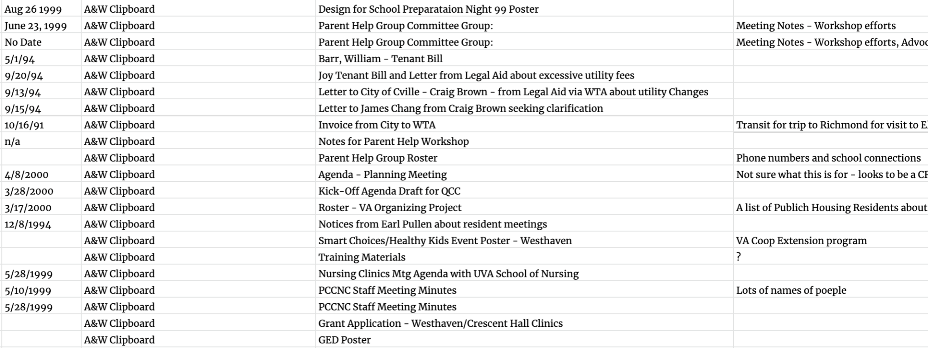

Slide 5
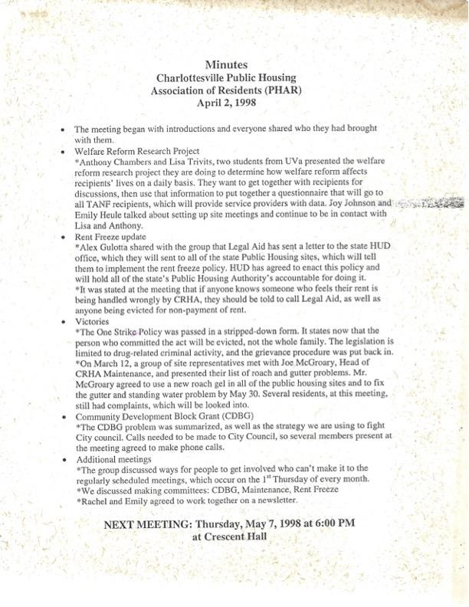

Slide 6
Who owns this knowledge?

Slide 7
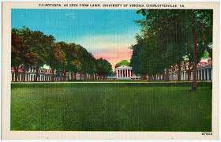
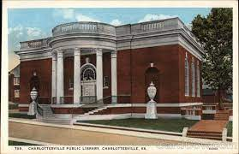

Slide 9
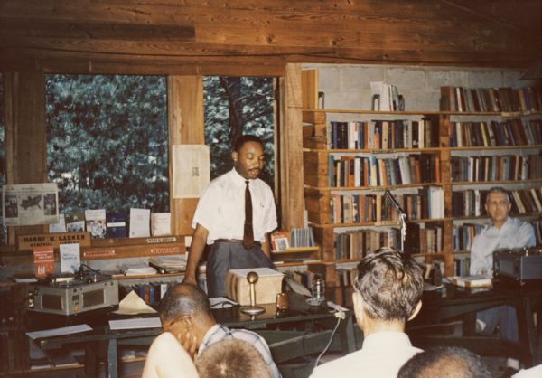

Slide 10
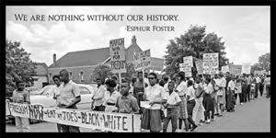

Slide 11
How are these materials actionable for the community?

Slide 12
Preservation
Digitization
Accessibility
Partnership

Slide 14
We recognize importance, but how do we integrate this into the broader efforts to realize housing as a human right?

