Slide 1
Donor Diapers
Created by,
Marissa Turner-Harris
"The Diaper Ladiiz"

Slide 2
What is Donor Diapers?

Slide 3
Donor Diapers is a nonprofit organization dedicated to “Leaving No Booties Behind”.
Donor Diapers was established in September 2017. Our mission is to solve diaper needs one booty at a time.

Slide 4
Why Is There A Donor Diapers?

Slide 5
Donor Diapers is the vision of Marissa Turner-Harris. Being a young parent, Marissa learned all too well about how expensive the diapering needs of a child was. She wondered to herself why wasn’t there an organization that was able to help struggling families with this expense.

Slide 6
Who is Donor Diapers?

Slide 7
We Are Donor Diapers!
Marissa Turner-Harris
Founder
Director of Operations

Slide 8
WE ARE DONOR DIAPERS!
Tina Turner
Director of Communications

Slide 9
WE ARE DONOR DIAPERS!
Karen Kingin
Director of Distribution

Slide 10
How Is the Organization Funded?

Slide 11
Since the start of this nonprofit we have been fortunate enough to be the recipient of a couple small grants.
The rest of our funding comes from community members’ donations.

Slide 12
How Do We Operate?

Slide 13
We set up in a centralized location.
We ask 3 Questions:
Do you have a child?
Can you provide proof of life in the form of (birth certificate, insurance card, hospital record or passport, etc.)?
Do you need diapers?

Slide 14
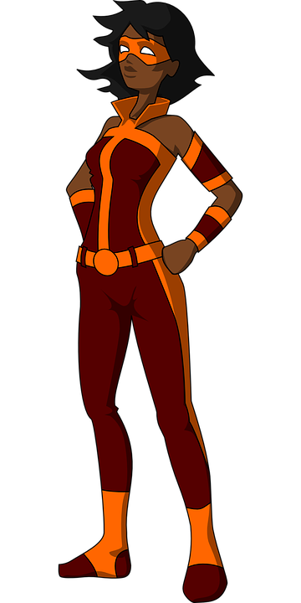
If you can answer yes to all of the previous questions then….
“No need to fear the diaperladiiz are here.”

Slide 15
When Can a Family Receive Our Services?

Slide 16
Upcoming Events Always 2:00pm-3:30pm

Slide 17
Contact Information
Facebook:
Donor Diapers
Instagram:
Donor Diapers
Call/Text:
434.214.0345

Slide 18
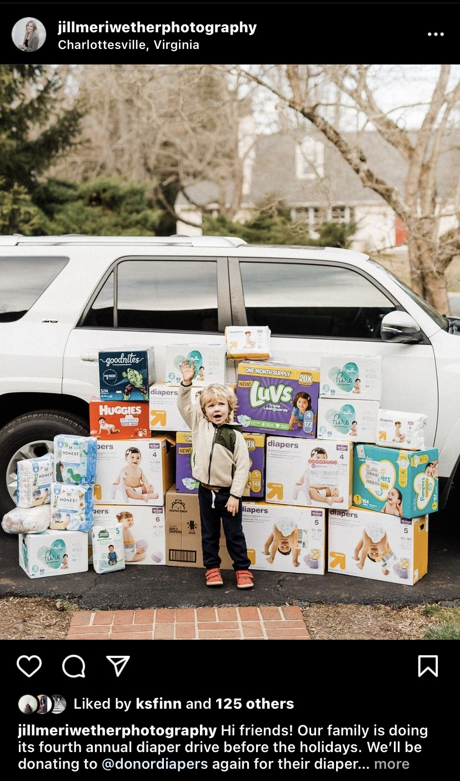
Sponsors
Kristin Finn
Jill Meriweather

Slide 19
Always remember every little thing will be okay!

